Slide 1


Network Adequacy
Data Governance & Planning
(Presentation materials/recording will be available @ https://rhld.insurance.arkansas.gov/NetworkAdequacy)
10:00 am-10:40 am Central
June 25, 2026
Compliance/Regulatory Health Link Division,
Arkansas Insurance Dept., Dept. of Commerce

Slide 2
Agenda
What to expect at the end of the reviews this year.
Provider Location Code- what’s that and why do I care?
What changed in the Justification template & why?
How would AID process issuers justifications and why should I care?
Kicking off the PTNP 2026 Round 2 – Provider Classification Data Maintenance.
Q&A

Slide 3
Agenda
What to expect at the end of the reviews this year.
Provider Location Code- what’s that and why do I care?
What changed in the Justification template & why?
How would AID process issuers justifications and why should I care?
Kicking off the PTNP 2026 Round 2 – Provider Classification Data Maintenance.
Q&A

Slide 4

Arkansas Network Adequacy Regulation Cycle
3) Isolated Outlier Provider Location Review
4) Plan Certification Review
(SERFF)
4) Objection Justifications & Final Determination Report
1) Provider Type Definition Maintenance
2) 2026
PTNP Data Maintenance
(Round1)
2) 2026
PTNP Data Maintenance
(Round 2)
Four Types of Processes
Provider-Type Definition Maintenance
Provider-Type-NPI-Pool (PTNP) data maintenance
Isolated Outlier Provider Location Review
NA data reporting and review
New for PY2027
We are here
Final Results
Network Adequacy Determination Report
Contested locations report

Slide 5
New in PY2027
Completed justification template (and updated NA templates if applicable) will be processed to generate the following for each network
Network Adequacy Determination Report with 3 possible status
  Accepted
  Conditionally accepted
  Deficient (Plans using “Deficient” networks will not be certified)
Contested Locations Report (if other issuers have contested your locations)
  The Department will keep track of contested locations across the years and may use third party investigators to examine persistent contests. Evidence of widespread and continued lack of care and diligence in either of the following would invite regulatory action.
  Contesting a location OR
  Correction of these locations when inaccurate

Slide 6
Agenda
What to expect at the end of the reviews this year.
Provider Location Code- what’s that and why do I care?
What changed in the Justification template & why?
How would AID process issuers justifications and why should I care?
Kicking off the PTNP 2026 Round 2 – Provider Classification Data Maintenance.
Q&A

Slide 7
Provider Location Code-1
CMS created a 10-digit NPI code to uniquely identify a provider. This has provided tremendous benefits in digital transactions within the healthcare industry and beyond.
  Typos or variations in the name of the provider are resolved
Geo-coding systems such as Google Maps/Apple Maps are able to generate unique long-lat coordinates for addresses.
  Variations in address entry are resolved (even able to resolve typos in some cases)
AID has taken advantage of 1) and 2), combining them to develop a Provider Location Code to uniquely identify a provider practicing location. With an accuracy of ~100 meter (~330 feet).
  This code has been developed to help with communications on Network Adequacy issues eliminating need to type in the NPI code along with the address in certain applications.
    Saving time.
    Eliminating possibility of address typos.
    Reducing erroneous contesting of provider locations.
    Enabling digital processing of provider locations in network adequacy dialog (such as in the Justification Templates)

Slide 8
Provider Location Code-cont’d
The Provider Location Code is
  Alpha-numeric
  Variable length (10-13 characters)
For example, AYVHG-1GR5JK represents
  Dr. Steven Wener, NPI 1114970084
  8040 Wolf River Blvd,
  Germantown, TN 38138

Slide 9
Provider Location Code-cont’d
Different practicing locations for a provider will have different Provider Location Codes.
For example: Dr. Steven Wener, NPI 1114970084 would have different codes for different locations
  AYVHG-1GR5JK : 8040 Wolf River Blvd, Germantown, TN 38138
  AYVHG-1GRFBE : 7715 Wolf River Blvd, Germantown, TN 38138
2. No provider other than NPI 1114970084 can have the above codes.

Slide 10
Provider Location Code-cont’d
Dr. Steven Wener, NPI 1114970084 was reported by issuers in PY2027 with 12 address variations. Geo-coding resolved all these variations to one location.
STREET_ADDRESS1 | STREET_ADDRESS2 | CITY | STATE | ZIP
8040 Wolf River Blvd Ste 200 |  | Germantown | TN | 38138-1775
8040 Wolf River Blvd Ste 103 |  | Germantown | TN | 38138-1773
8040 Wolf River Blvd Ste 102 |  | Germantown | TN | 38138-1773
8040 Wolf River Blvd Ste 102 |  | Germantown | TN | 38138
8040 Wolf River Blvd Ste 103 |  | Germantown | TN | 38138
8040 Wolf River Blvd Ste 200 |  | Germantown | TN | 38138
8040 WOLF RIVER BLVD | # 102 | GERMANTOWN | TN | 38138
8040 WOLF RIVER BLVD | # 102 | MEMPHIS | TN | 38138
8040 WOLF RIVER BLVD | # 103 | GERMANTOWN | TN | 38138
8040 WOLF RIVER BLVD | # 200 | GERMANTOWN | TN | 38138
8040 Wolf River Blvd |  | Germantown | TN | 38138
8040 Wolf River Blvd | Ste 103 | Germantown | TN | 38138

Slide 11
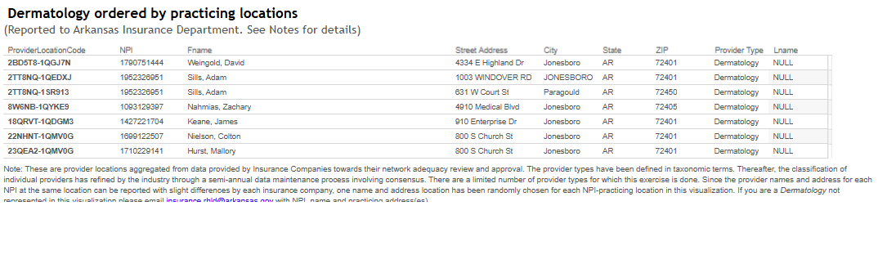
Provider Location Code-cont’d
Where is the Provider Location Code?
Starting PY2027, visualizations or reports furnished by the Department will have Provider Location Codes for provider practicing locations. (Eg Consolidated Provider Visualization in AID’s website, or the visualizations accompanying the Justification Template)

Slide 12
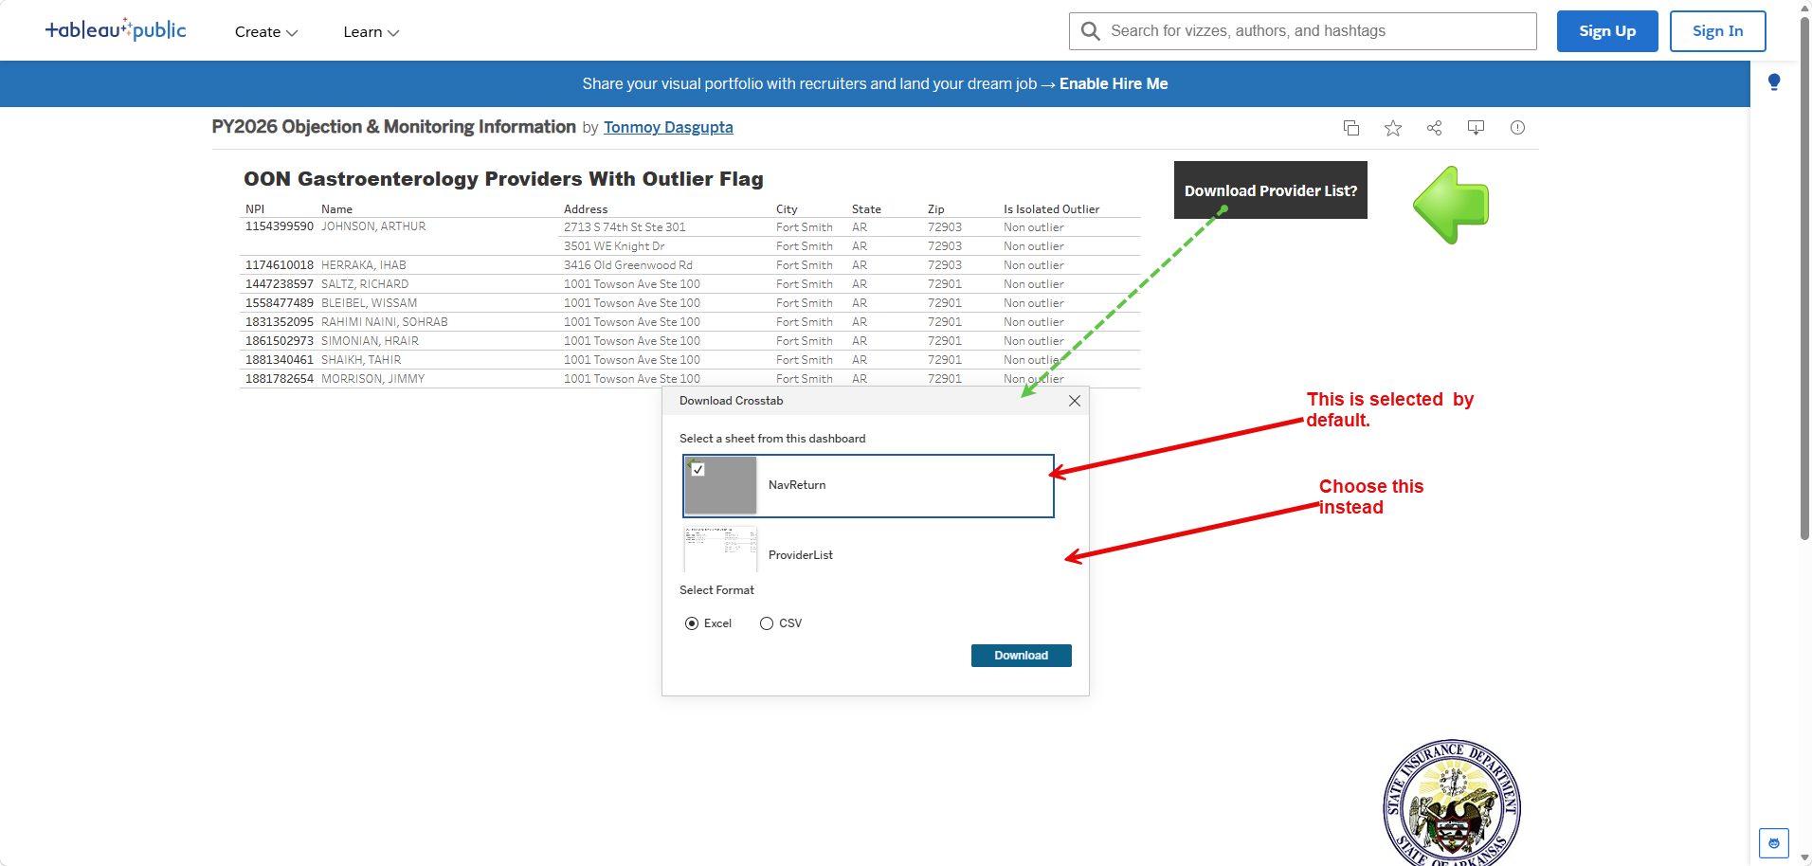
An unresolved quirk
While using the visualization provided in the Justification template, issuers often want to download selected providers listings, near, or inside a deficient county. Issuers are reminded of the workaround below through the picture below

Slide 13
Agenda
What to expect at the end of the reviews this year.
Provider Location Code- what’s that and why do I care?
What changed in the Justification template & why?
How would AID process issuers justifications and why should I care?
Kicking off the PTNP 2026 Round 2 – Provider Classification Data Maintenance.
Q&A

Slide 14
What changed in the Justification template?
There have been changes in two basic areas.
Added tab called Data Issues.
Refinement of justification reasons and corresponding navigation.

Slide 15
Data Issues tab
The additional tab does mean additional data reporting than in PY2026.
The Data Issues tab segregates some of the detailed provider level responses that did not fit under the label of Network Development.
Justification such as the following are not truly Network Development
Issuer disagrees with provider location reported by others
Provider classification issues in the PTNP (either addition or removal or both)

Slide 16
Data Issues tab- contd
When adopting the idea of the customized Justification template from CMS-CCIIO, the Department tried to be as close to their design as possible - it seemed time tested. However, the Department realized that CMS-CCIIO does not provision dialog on data deficiencies because it lacks two unique Arkansas achievements within its regulatory design:
Arkansas issues objections only when it believes that there is scope for improvement (by comparing deficiencies against a hypothetical ideal network computed by aggregating provider locations from all issuers).
Arkansas has a collaborative data governance process around the classifications of providers (PTNP process).

Slide 17
Refinement of justification reasons
The Department took advantage of one year of actual field experience with the customized justification template to study the justification responses from all issuers. The following refinements resulted
Added a necessary response missed the first year (PTNP classification removals)
Eliminated reasons that were never used, and in hindsight seemed inapplicable
Edited some reasons for better clarity

Slide 18
Agenda
What to expect at the end of the reviews this year.
Provider Location Code- what’s that and why do I care?
What changed in the Justification template & why?
How would AID process issuers justifications and why should I care?
Kicking off the PTNP 2026 Round 2 – Provider Classification Data Maintenance.
Q&A

Slide 19
How AID Uses Justification Data
When an objection is made, there are three broad responses available to issuers:
  The issuer has provider locations to satisfy requirements that were not included in the calculations
  The issuer is attempting to add existing providers to our network
  Providers that AID claims can improve compliance are not valid for the criteria or location indicated

Slide 20
How AID Uses Justification Data
When an objection is made, there are three broad responses available to issuers:
  The issuer has provider locations to satisfy requirements that were not included in the calculations
  The issuer is attempting to add existing providers to our network
  Providers that AID claims can improve compliance are not valid for the criteria or location indicated
Starting with PY2027, these two claims will be evidence-tested.

Slide 21
How AID Uses Justification Data
How are additional providers tested?
A “hypothetical network” is created with the potential additions from Network Development and Data Issues (PTNP additions).
This network is recalculated using the drive distance algorithms.
Results are compared to the existing ideal network.
Coverage improvement is reported to regulators to factor into their determinations.

Slide 22
How AID Uses Justification Data
When an objection is made, there are three broad responses available to issuers:
  The issuer has provider locations to satisfy requirements that were not included in the calculations
  The issuer is attempting to add existing providers to our network
  Providers that AID claims can improve compliance are not valid for the criteria or location indicated
What about these? and “Other” justifications?

Slide 23
How AID Uses Justification Data
How are disputed provider locations judged?
AID will not adjust the existing ideal network.
Individual evidence will be evaluated to support the dispute
Be thorough and provide proof.
Often there are multiple available providers; disputing one as inaccurate does not solve the objection.
AID regulators will make the final determination.

Slide 24
Agenda
What to expect at the end of the reviews this year.
Provider Location Code- what’s that and why do I care?
What changed in the Justification template & why?
How would AID process issuers justifications and why should I care?
Kicking off the PTNP 2026 Round 2 – Provider Classification Data Maintenance.
Q&A

Slide 25
Complained about PTNP issues?
Issuers complaining about PTNP classification in the Data Issues tab are expected to
  Participate in the PTNP provider classification governance process.
  Abide by the outcome (industry consensus) – and refrain from complaining about the same issue every year.

Slide 26
Unfamiliar with the PTNP process?
The Department expects the Issuers to maintain institutional knowledge about participating in the PTNP data governance process.
However, if unfamiliar and uneasy with the subsequent slides on the PTNP process, issuer should not hesitate to contact the Department @ RHLD.DataOversight@arkansas.gov Appendix has some materials for the uninitiated.

Slide 27






http://rhld.insurance.arkansas.gov/Default/NetworkAdequacy
2026 Round 2 Initial Provider Type-NPI Pool
(Expect by June 30, 2026)
Add? Delete?
Blue Cross Experts
“20260803_83470_BCBS_Provider_Type_NPI_AddDelete.csv”
(Due Aug 3, 2026)
AID Secure FTP Server
Stage 1: “Suggestion for changes” stage illustrated using BCBS as an example

Slide 28


http://rhld.insurance.arkansas.gov/Default/NetworkAdequacy
"Industry Provider Type Addition-Deletion
suggestions" (Expected August 17, 2026)
To agree or not to agree on this addition and that removal?
Ambetter Experts
“20260917_80799_Ambetter_ObjectionVote.csv”
(Due September 17, 2026)
AID Secure FTP Server
Stage 2: “Voting” stage illustrated using Ambetter as an example

Slide 29

Expectations from Issuers
Refer pdf document NA Review Process located in http://rhld.insurance.arkansas.gov/Default/NetworkAdequacy (NA website)
  Issuers provides suggestions for change. Due on August 3, 2026.
  AID collects these suggestions and posts the consolidated information on NA website on August 17, 2026.
  Issuers vote their agreement or opposition to suggested changes by others. Due September 17, 2026.
  AID processes votes and updates the PTNPs on NA website on October 30, 2026.

Slide 30


Questions?
Email
RHLD.DataOversight@arkansas.gov
Or call
Tonmoy Dasgupta (501-773-0420) Cell

Slide 31
Appendix
Reference slides for new issuer personnel

Slide 32
New to THE Program?
Arkansas Network Adequacy Regulation

Slide 33
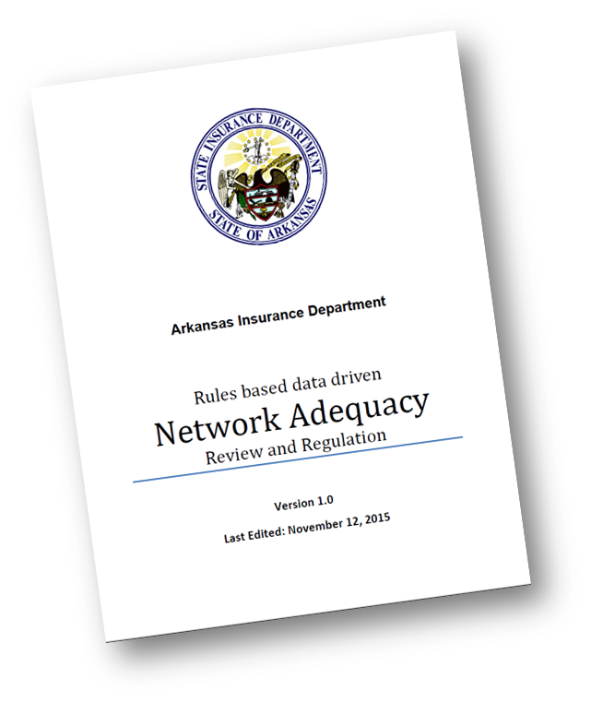
New to Arkansas NA Regulation Program?
Two important documents to read
Program details available at http://rhld.insurance.arkansas.gov/Default/NetworkAdequacy
  “NA Review Process”
    This document lays out NA activities for the coming plan year
  Meeting slides and notes maintained in chronological order
Data specifications & templates updated at http://rhld.insurance.arkansas.gov/Info/Public/Templates
    For data submission requirements refer “SERFF Network Adequacy Data Submission Instructions”
  New issuers can call AID for an overview with Q&A.

Slide 34
Network Adequacy Overview
There are two major types of processes within the NA review in Arkansas.
Provider-Type-NPI-Pool (PTNP) data maintenance .
NA data reporting and review.

Slide 35
How is data exchanged in the PTNP process?
From AID to issuers:
AID’s Network Adequacy (NA) webpage (http://rhld.insurance.arkansas.gov/Default/NetworkAdequacy)
For file names refer Network Adequacy Review Process.pdf located in the same webpage.
From issuers to AID:
Delivery to AID’s secure FTP servers following instructions in “General Data Submission Process to RHLD” located at http://rhld.insurance.arkansas.gov/Info/Public/Templates. For file naming conventions during the two stages of issuer feedback refer Network Adequacy Review Process.pdf located in AID’s NA webpage.
Data submissions from issuers explained with examples in later slides.

Slide 36
AID Disposition Details
AID provides detailed information on the outcome of the voting stage.
This makes available cases where AID had to
  wade in to settle tie breakers OR
  reverse a popular vote based on a strong(er) reason provided by the minority (few cases)

Slide 37
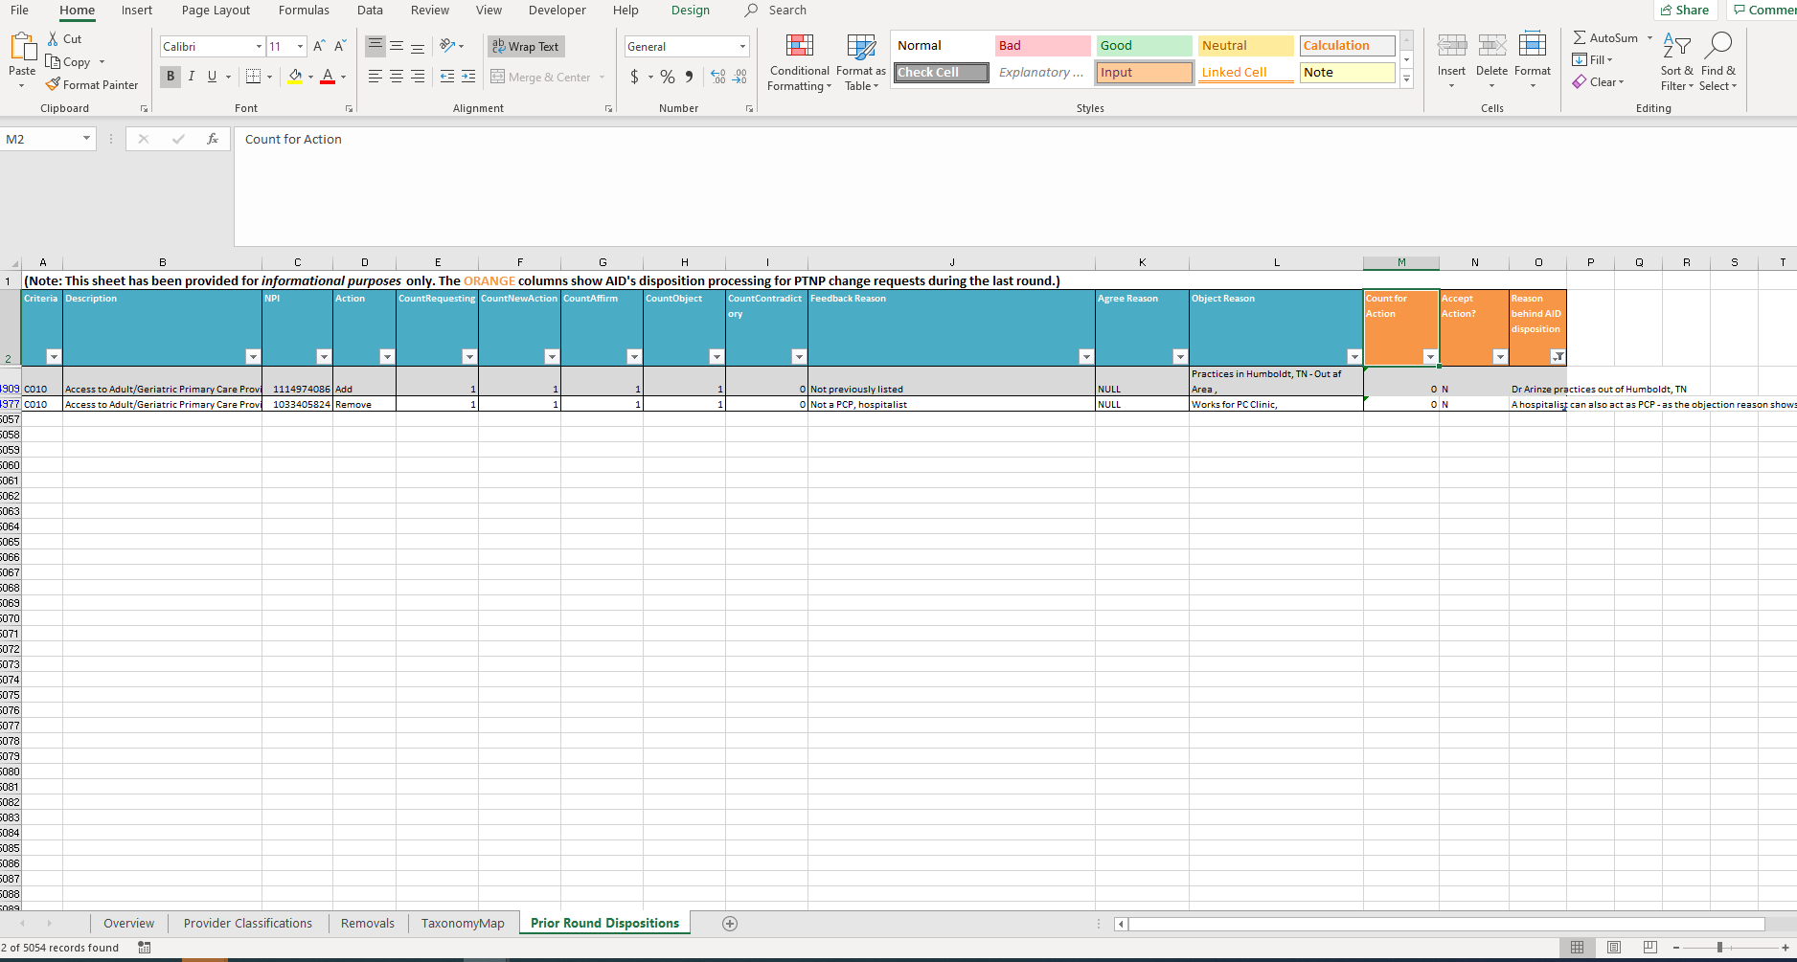
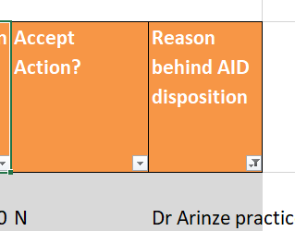
Initial Provider Type NPI pool template

Slide 38
Errors to avoid during Stage 1: “Suggestions for change” (1 of 3)
Please understand that PTNP data maintenance is NOT just about your network(s) alone. DO not attempt to remove a provider who is not in your network anymore but may work for others.
Please understand that our PTNP data maintenance attempts to focus on actual provider practice rather than academic qualifications. For example, a provider who is qualified in “Internal Medicine” but is known to work only in the ER of a hospital, should not be classified as a Primary Care Provider.
Please remember we are communicating about correcting classifications of NPIs (i.e. Providers). Not whether a NPI (i.e. Provider) exists. Each line communicates either addition of an NPI to a “C-bucket” –OR- removal of an NPI from a “C-bucket”.
A misclassified NPI *may* require two or more suggestions. One would be a removal from the incorrect “C-bucket” and if not already assigned to the applicable “C-bucket(s)”, addition(s) to the correct “C-bucket(s)”. Sometimes a misclassification may require only one suggestion- a removal from a “C-bucket” with no concomitant addition suggestions, since an appropriate “C-bucket” does not exist for the NPI.
Try not to approach the PTNP data maintenance with an inclination towards one type of action (say an inclination towards either addition or deletion). AID tends to compare competitor networks before issuing an objection. Just focusing on say additions and not on removal of inaccurate NPI classifications may not help you in AID’s comparative analysis. Please approach the PTNP data maintenance as an effort towards accurate classification.
While adding bordering state providers, please remember that AID does not have any “contiguous county” requirement. But bear in mind though that adding providers very far from the borders may not help with your average distance calculations. Add providers in bordering states that Arkansans do avail – because your consumers are probably the best judge.

Slide 39
Errors to avoid during Stage 1: “Suggestions for change” (2 of 3)
While removing a misclassification for a provider be careful not to remove other classification for the same NPI that may be correct.
  For instance while cleaning up misclassified Endocrinologist NPIs, AID observed issuers removing correct association of those NPIs with Oncology.
While adding a NPI to a “C-bucket”, please pay heed to the taxonomic definition of the “C-bucket”. Same consideration applies when looking for removals.
  For instance the current definition of C250 (Access to Dental – General) does not include Pediatric Dentists, so do not add them to “Dental General”. Conversely if you know an NPI listed in “Dental – General” is an Pediatric Dentist by practice, ask for its removal.
Do provide your most compelling reason for an addition or deletion. Each issuer’s reasons behind an addition or removal is shown to all issuers during the voting round and may influence their feedback. During vote processing AID may overrule the direction of a vote based on the strength of an issuer’s reason.
  An example of a compelling reason for removal of a PCP can be a brief “Works only in emergency medicine in our 2016 claims data”.
Download and use the correct template to suggest changes. Please do not fashion your own spreadsheet.
AID had observed significant feedback in the voting stage (that comes later) saying that a particular NPI should belong to some other bucket. Please understand that the “Suggestions for change” stage is the stage to add or remove from an classification. The voting stage that comes later, is not the place to make addition or removal suggestions.

Slide 40
Errors to avoid during Stage 1: “Suggestions for change” (3 of 3)
When a facility changes ownership, it gets a new NPI. When adding this NPI remember to delete the NPI associated with the previous owner.
Before adding an NPI to a provider bucket, ensure that the NPI does not already exist in that bucket.
Remember – we are doing this data maintenance because the NPI Registry does not have the adequate data quality for provider classifications. Therefore, do not be quick to re-classify a provider existing in the PTNP final list solely based on the taxonomy in the NPI Registry

Slide 41
Errors to avoid during Stage 2:
“Voting” stage (1 of 1)
Most network data considerations during the “add-remove” stage also apply to the “Voting” stage; Taxonomic definitions, Out-of-state provider distance considerations, etc. should be considered.
  For example, before objecting to some other issuer’s removal of an apparently valid NPI-”C bucket” combination, consider if the provider is out of state, and if all practicing locations are far from the border.
Please use the recommended template.
Please remember that this stage is only to communicate your agreement or rejection of a suggested change of provider classification. It is not about communicating whether a NPI (i.e. Provider) exists – or – that the provider is miss-classified and should belong to a different bucket. While rejecting an addition suggestion, if you realize that the NPI belongs to a different C-bucket, your opportunity for suggesting the addition to the appropriate C-bucket(s) will be in future PTNP data maintenance rounds. Suggestion to add to a different C-bucket cannot be handled at this stage.
Do provide your most compelling reason behind rejecting an addition or deletion. AID may use the strength of your reason to settle a tie, or even reverse the direction of a vote.
  An example of a compelling reason for rejecting addition of a NPI as a PCP can be a terse “Works only in emergency rooms per claims data”.

